Slide 1
Data Ingestion
Emanuele Della Valle
Prof. @ Politecnico di Milano
Founder & Partner @ Quantia Consulting
Marco Balduini
Founder & CEO @ Quantia Consulting
Riccardo Tommasini
Prof. @ INSA Lyon (France)

Slide 2
Introduction

Slide 3
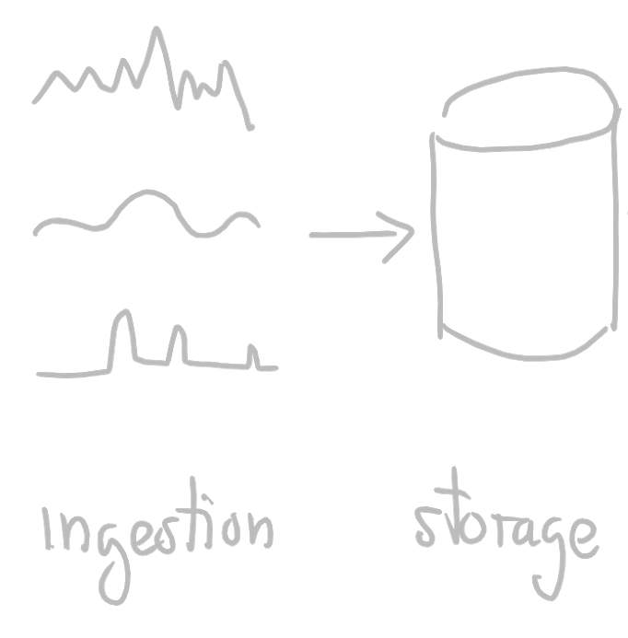
Data Lifecycle

Slide 4
Data Lifecycle

Slide 5
Data Lifecycle

Slide 6
What’s a time series?

Slide 7
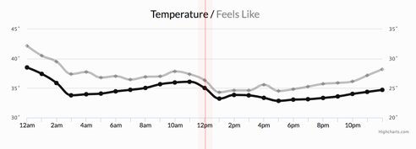
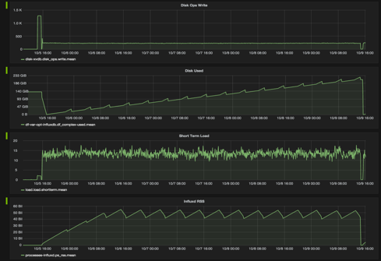
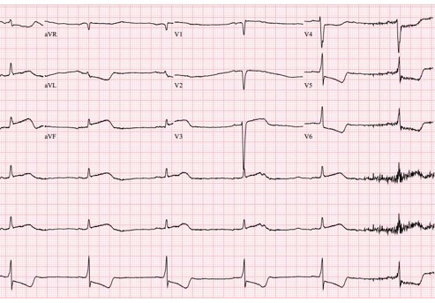
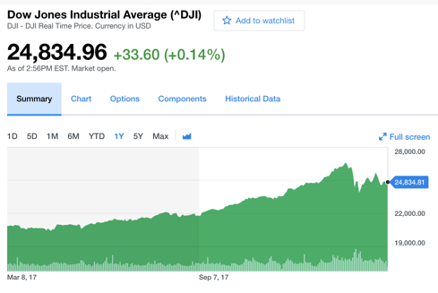
Let’s start by example
Weather conditions
Stock exchange
Healthcare
Cluster monitoring

Slide 8
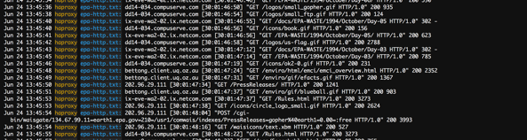
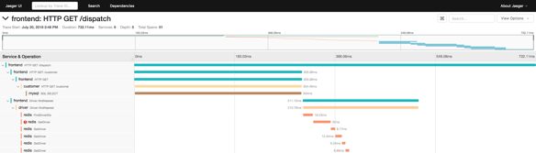
Now some different type of time series
Logs
Traces

Slide 9
What’s the difference?
VS.

Slide 10
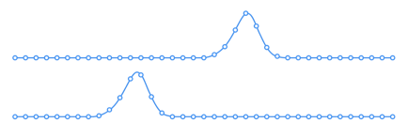
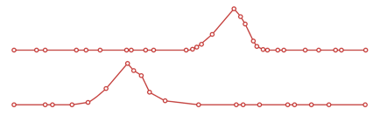
What’s the difference?
both of them are time series, but …
We monitor the phenomena
The phenomena happen and we observe them
VS.

Slide 11
What’s the difference?
both of them are time series, but …
We monitor the phenomena
The phenomena happen and we observe them
regular
VS.

Slide 12
What’s the difference?
both of them are time series, but …
We monitor the phenomena
The phenomena happen and we observe them
regular
irregular
VS.

Slide 13
What’s the difference?
both of them are time series, but …
We monitor the phenomena
The phenomena happen and we observe them
regular
irregular
VS.
metrics

Slide 14
What’s the difference?
both of them are time series, but …
We monitor the phenomena
The phenomena happen and we observe them
regular
irregular
VS.
metrics
events

Slide 15
Metrics
Regular Time Series
Measurements gathered at regular time intervals

Slide 16

Metrics
Events
Regular Time Series
Irregular Time Series
Measurements gathered at regular time intervals
Measurements observed at irregular time intervals

Slide 17
Summarization of Events
turns events into metrics, for example

Slide 18
Summarization of Events
turns events into metrics, for example
Summarizing the average trade price of Apple stock every 10 minutes over the course of a day

Slide 19
Summarization of Events
turns events into metrics, for example
Summarizing the average trade price of Apple stock every 10 minutes over the course of a day
Summarizing the average response time for requests in an application over 1 minute intervals

Slide 20
Characteristics of the time series
All Time-stamped data
Generated in
regular (Metric) and
irregular (Event) time periods
Huge volumes of data
High variety of semi-structured data
Real-time
Time sensitive

Slide 21
How is data ingested?

Slide 22
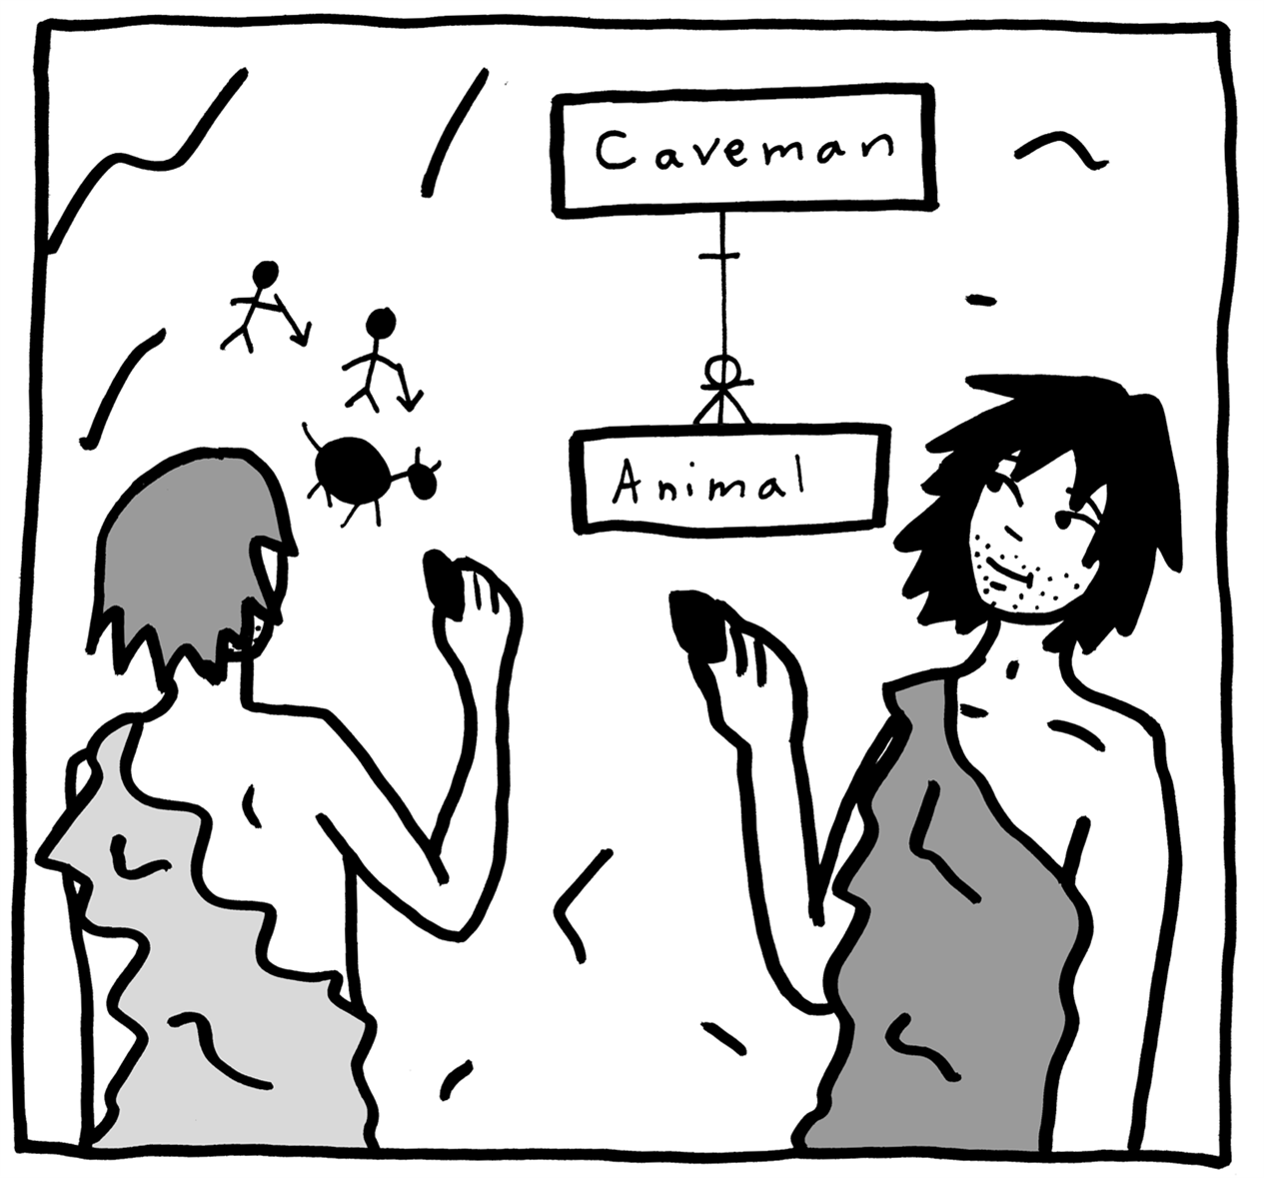
Conceptual vs. logical vs. physical views
[Src: https://www.oreilly.com/library/view/data-modeling-made/9781935504481/ ]

Slide 23
How is data ingested? Conceptual View

Slide 24
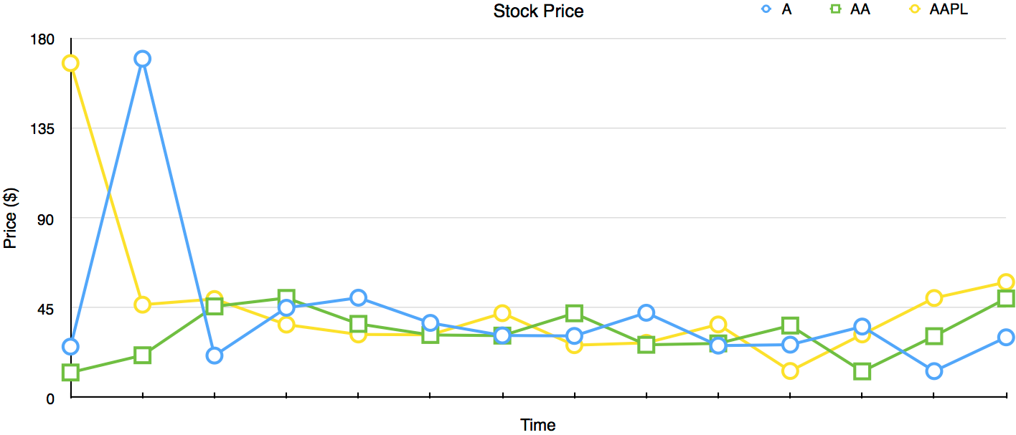
Let’s start from the anatomy of a Time-Series Line Graph

Slide 25
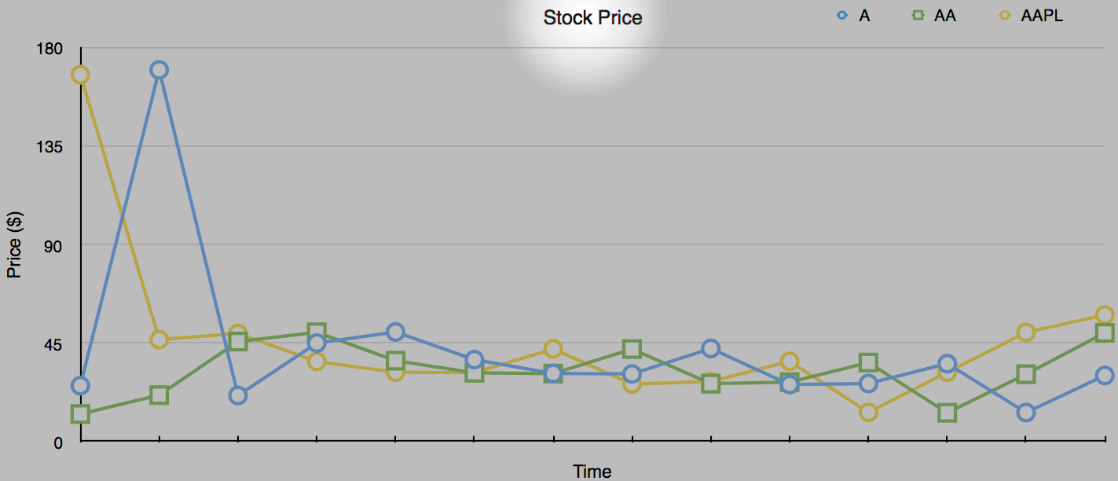
The type of measurement is the title of the Line Graph

Slide 26
Data Model
Measurement
The name of the measurement used as high level grouping of data
Tag set
Other lower level grouping criteria of data
Fields
Actual data
Timestamp
Time of the data
Series
A unique combination of measurement+tags

Slide 27
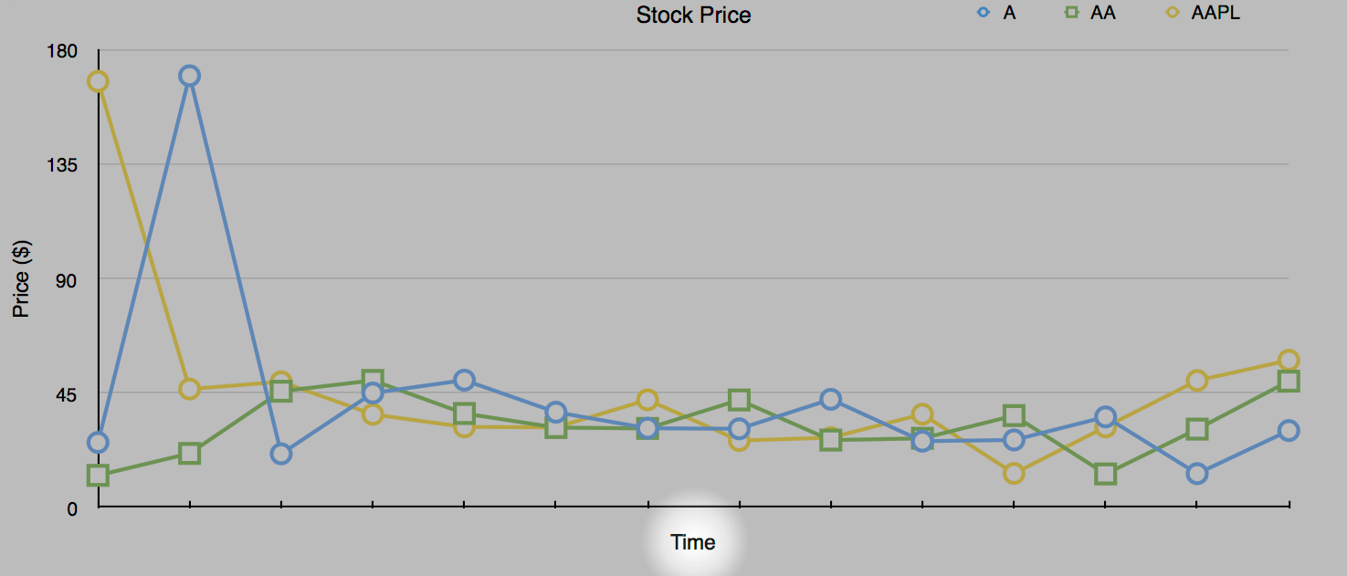
Time stamps are on the X-Axis

Slide 28
Data Model
Measurement
The name of the measurement used as high-level grouping of data
Tag set
Other lower level grouping criteria of data
Fields
Actual data
Timestamp
Time of the data (better if the time the data is observed)
Series
A unique combination of measurement+tags

Slide 29
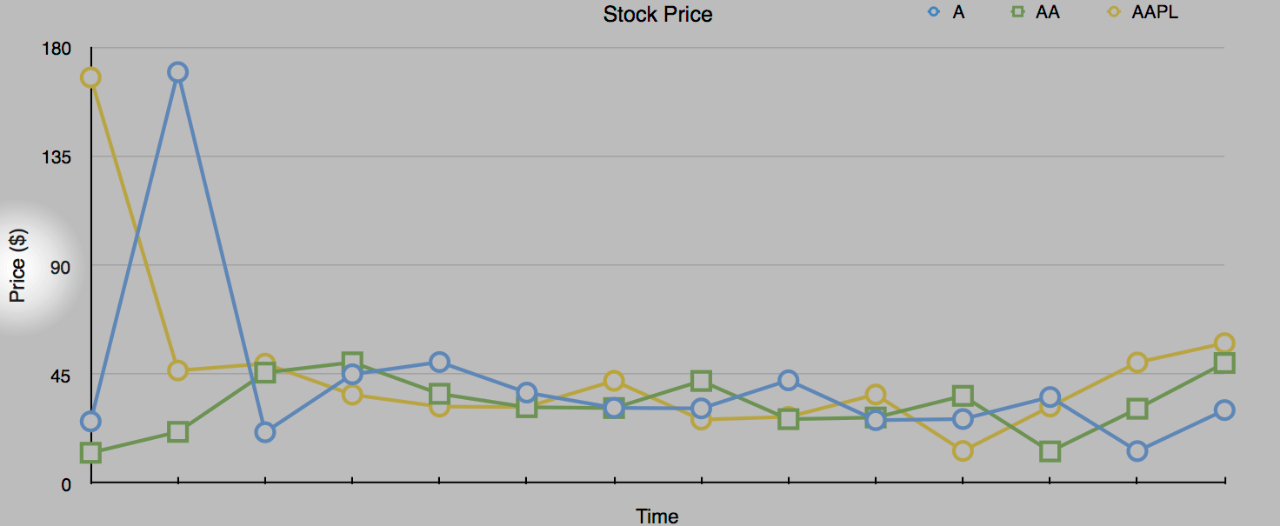
Data is on the Y-Axis

Slide 30
Data Model
Measurement
The name of the measurement used as high-level grouping of data
Tag set
Other lower level grouping criteria of data
Field set
Actual data
Timestamp
Time of the data (better if the time the data is observed)
Series
A unique combination of measurement+tags

Slide 31
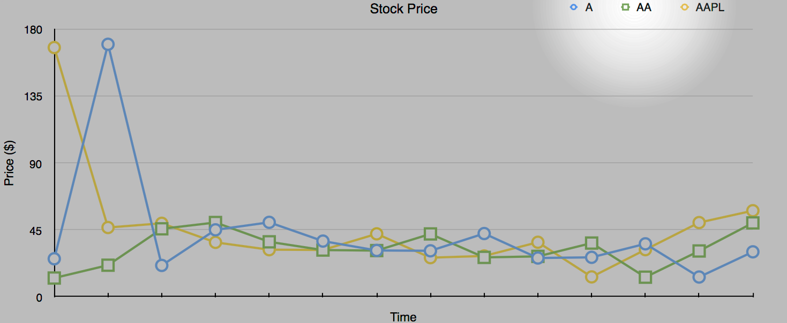
The Legend distinguishes the three time series in the graph

Slide 32
Data Model
Measurement
The name of the measurement used as high-level grouping of data
Tag set
Other lower-level grouping criteria of data
Field set
Actual data
Timestamp
Time of the data (better if the time the data is observed)
Series
A unique combination of measurement+tags

Slide 33
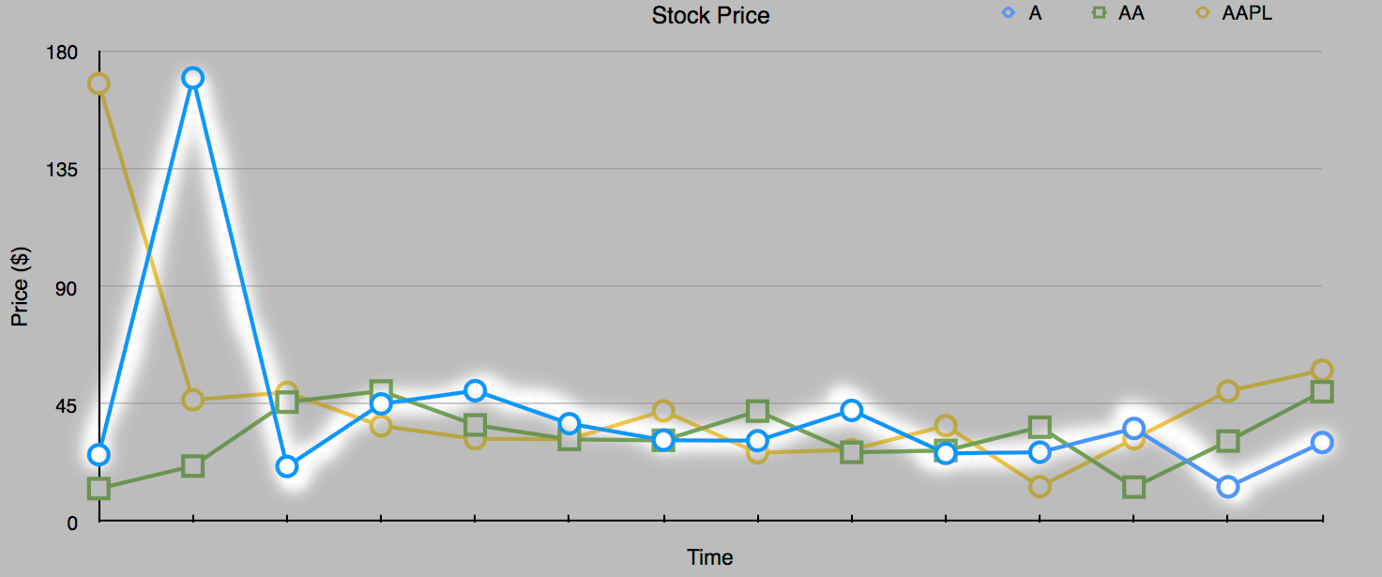
A series in the graph thus is …

Slide 34
Data Model
Measurement
The name of the measurement used as high-level grouping of data
Tag set
Other lower-level grouping criteria of data
Field set
Actual data
Timestamp
Time of the data (better if the time the data is observed)
Series
Data points in time order grouped by measurements and tags

Slide 35
How is data ingested? Logical View

Slide 36
Data Model
Measurement
A name to group data at high level
Tag set
A set of key-value pairs to group data at low level (values are strings)
Field set
A set of key-value pairs to represent data (values are numerical & strings)
Timestamp
Time of the data with nanosecond precision
Series
A unique combination of measurement+tags

Slide 37
Data model vs ingestion & storage

Slide 38
Data model vs ingestion & storage
Measurement
Tag set
Field set
Timestamp

Slide 39
Data model vs ingestion & storage
Series
Measurement
Tag set
Field set
Timestamp

Slide 40
Data model vs ingestion & storage
Series
Buckets
(set of series)
Measurement
Tag set
Field set
Timestamp

Slide 41
How is data ingested? Physical View

Slide 42

An example of Line Protocol
obs,host=ovenA,num=1,region=west temp=301,hum=23 1492214400000000000
Measurement

Slide 43

An example of Line Protocol
obs,host=ovenA,num=1,region=west temp=301,hum=23 1492214400000000000
Tags

Slide 44
An example of Line Protocol
whitespace
obs,host=ovenA,num=1,region=west temp=301,hum=23 1492214400000000000
Tags

Slide 45
An example of Line Protocol
obs,host=ovenA,num=1,region=west temp=301,hum=23 1492214400000000000
Fields

Slide 46
An example of Line Protocol
whitespace
obs,host=ovenA,num=1,region=west temp=301,hum=23 1492214400000000000
Fields

Slide 47
An example of Line Protocol
obs,host=ovenA,num=1,region=west temp=301,hum=23 1492214400000000000
timestamp
Reference: https://v2.docs.influxdata.com/v2.0/reference/line-protocol/

Slide 48
Bucket physical view
Columnar Data Stores
Best for column selection and aggregation thanks to
Disk + Memory locality
Cache locality
_time
_m
host
num
line
temp
humidity
1492…1
obs
ovenB
1
west
301
23
1492…0
obs
ovenA
1
west
125
75
…
…
…
…
…
…
…
_m = _measurement
tags
fields

Slide 49
So, the line protocol representations of two metrics are …

Slide 50
So, the line protocol representations of two metrics are …

Slide 51
So, the line protocol representations of two metrics are …
stock_price,ticker=A price=170 1465839830100400200

Slide 52
So, the line protocol representations of two metrics are …
stock_price,ticker=A price=170 1465839830100400200

Slide 53
So, the line protocol representations of two metrics are …
stock_price,ticker=A price=170 1465839830100400200
stock_price,ticker=AA price=42 1465839840100400200

Slide 54
How is data automatically ingested?

Slide 55
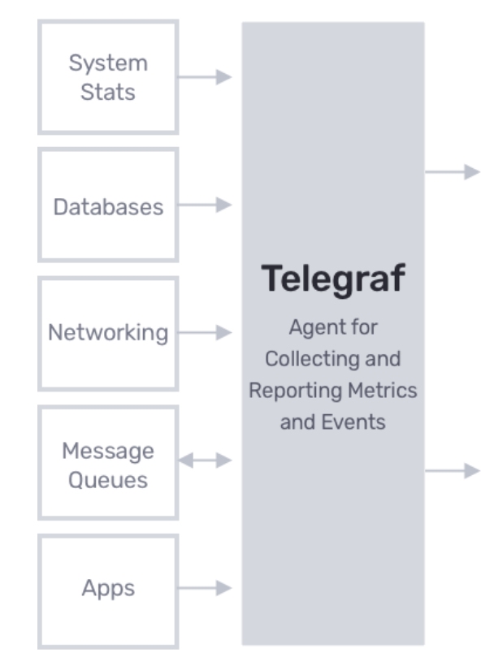
Telegraf
Telegraf is a data collection agent
It is based on a Plug and Play architecture
It offers a variety of input plugins
It can be configured from the InfluxDB cloud UI
Download and install: https://docs.influxdata.com/telegraf/latest/introduction/installation/
Notes:
Advertise telegraf training?

Slide 56
Positioning Telegraf in the ingestion pipeline
Telegraf

Slide 57
Quiz
Provide the correct relationship — 1:1, 1:N, N:1, or N:N
1 time series to ? measurement
1 time series to ? tag (key-value pair)
1 time series to ? field key
? field key to ? field value
1 time series to ? timestamp
1 <measurement,tag,field key,timestamp> to ? value

Slide 58
Quiz
Provide the correct relationship — 1:1, 1:N, N:1, or N:N
1 time series to N measurement
1 time series to ? tag (key-value pair)
1 time series to ? field key
? field key to ? field value
1 time series to ? timestamp
1 <measurement,tag,field key,timestamp> to ? value

Slide 59
Quiz
Provide the correct relationship — 1:1, 1:N, N:1, or N:N
1 time series to N measurement
1 time series to N tag (key-value pair)
1 time series to ? field key
? field key to ? field value
1 time series to ? timestamp
1 <measurement,tag,field key,timestamp> to ? value

Slide 60
Quiz
Provide the correct relationship — 1:1, 1:N, N:1, or N:N
1 time series to N measurement
1 time series to N tag (key-value pair)
1 time series to N field key
? field key to ? field value
1 time series to ? timestamp
1 <measurement,tag,field key,timestamp> to ? value

Slide 61
Quiz
Provide the correct relationship — 1:1, 1:N, N:1, or N:N
1 time series to N measurement
1 time series to N tag (key-value pair)
1 time series to N field key
N field key to N field value
1 time series to ? timestamp
1 <measurement,tag,field key,timestamp> to ? value

Slide 62
Quiz
Provide the correct relationship — 1:1, 1:N, N:1, or N:N
1 time series to N measurement
1 time series to N tag (key-value pair)
1 time series to N field key
N field key to N field value
1 time series to N timestamp
1 <measurement,tag,field key,timestamp> to ? value

Slide 63
Quiz
Provide the correct relationship — 1:1, 1:N, N:1, or N:N
1 time series to N measurement
1 time series to N tag (key-value pair)
1 time series to N field key
N field key to N field value
1 time series to N timestamp
1 <measurement,tag,field key,timestamp> to 1 value

Slide 64

Let’s get dirty!
1

Slide 65
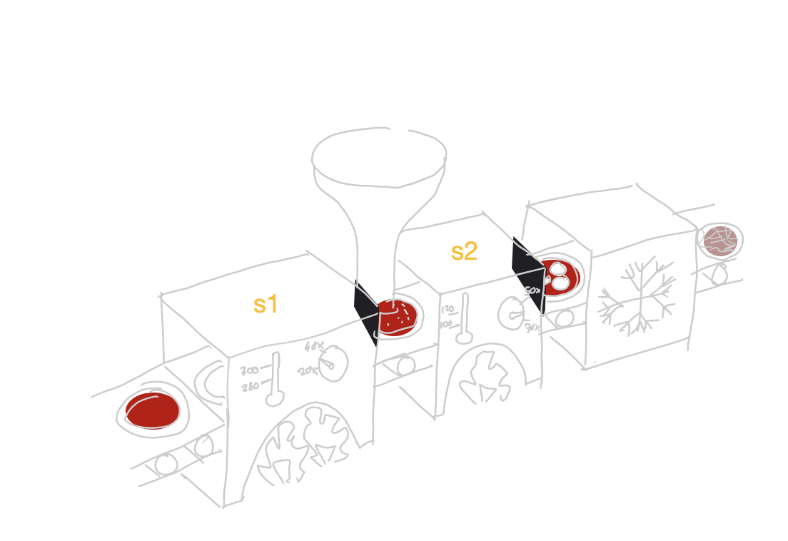
Use Case: Continuous Linear Pizza Oven
Sensors observe
temperature (C°)
relative humidity (%)
of the two ovens
Learning Goals
Line protocol usage
First query

Slide 66
Task 1
Model the following data representing the temperature and the humidity observations, from both sensors, over time.
component | sensor | temperature | humidity | ts
iot-oven | S1 | 290 | 30 | 1633953600000000000
iot-oven | S2 | 105 | 55 | 1633953615000000000
iot-oven | S1 | 305 | 38 | 1633953660000000000
iot-oven | S2 | 120 | 65 | 1633953675000000000

Slide 67
Task 2
Load data into an InfluxDB bucket named training
iot-oven,sensor=S1 temperature=290,humidity=30 1633953600000000000
iot-oven,sensor=S2 temperature=105,humidity=55 1633953615000000000
iot-oven,sensor=S1 temperature=305,humidity=38 1633953660000000000
iot-oven,sensor=S2 temperature=120,humidity=65 1633953675000000000
…

Slide 68
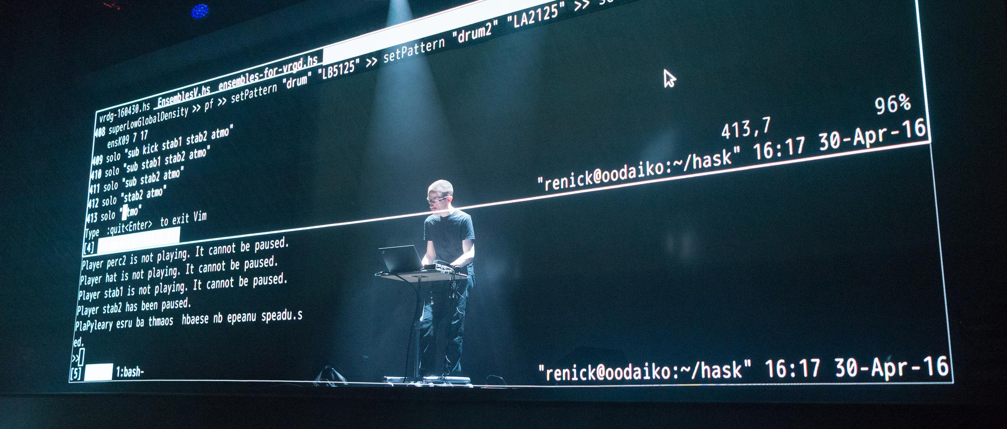
Let’s do some live coding

Slide 69
Task 3
Run you first query
from(bucket: "training")
|> range(start: v.timeRangeStart, stop: v.timeRangeStop)
|> filter(fn: (r) => r._measurement == "iot-oven")
|> filter(fn: (r) => r._field == "temperature")
|> filter(fn: (r) => r.sensor == "S2")
|> filter(fn: (r) => r._value > 100)

Slide 70

Quiz
Should a bucket contain the same number of distinct measurements, tag keys, tag values, field keys, field values, and timestamps the same?
If not, please put them in order using:
>> (at least an order of magnitude more)
~ (about the same order of magnitude)
e.g., field values >> field keys

Slide 71
Quiz answers
Should a bucket contain the same number of distinct measurements, tag keys, tag values, field keys, field values, and timestamps the same?
If not, please put them in order using:
>> (at least an order of magnitude more)
~ (about the same order of magnitude)
timestamps >> field values >> tag values >> field keys ~ tag keys >> measurements

Slide 72
Data Ingestion
Emanuele Della Valle
Prof. @ Politecnico di Milano
Founder & Partner @ Quantia Consulting
Marco Balduini
Founder & CEO @ Quantia Consulting
Riccardo Tommasini
Prof. @ INSA Lyon (France)

